Slide 1
Our God, He is Alive
Hickory Knoll Church of Christ
www.hkcofc.com

Slide 2
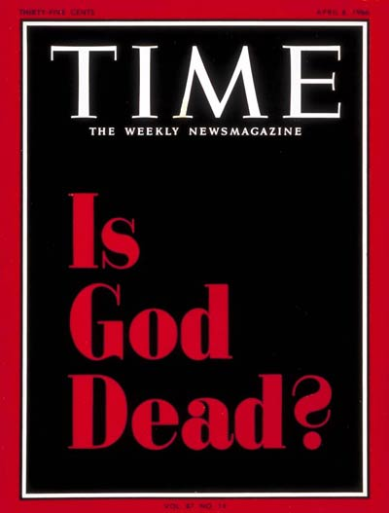

Slide 3
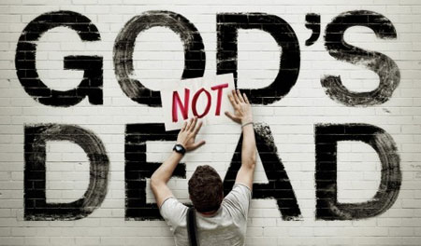

Slide 4
Creation
(Genesis 1-2)

Slide 5
Credibility
(Romans 15:4 & II Timothy 3:16-17)

Slide 6
Crucifixion
(Luke 23:26-24:7)

Slide 7
Conclusion: "I AM"
(Revelation 1:8 & 22:13)

