Slide 1
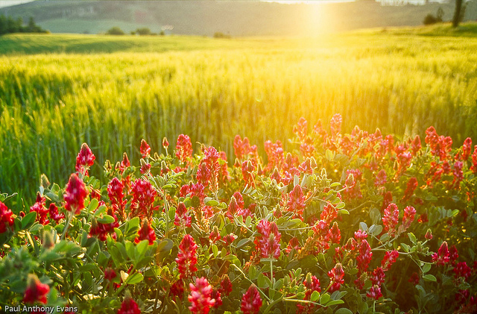
RESURRECTION
DAY

Slide 2
What is the
Resurrection?

Slide 3
What happens
When I die?

Slide 4
What happens to
My Spirit?

Slide 5
What happens to
My Body?

Slide 6
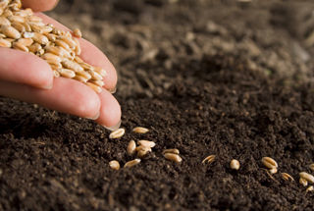
How is
my body like
a seed?

