Slide 1
The Depths of the Sea
Hickory Knoll Church of Christ
www.hkcofc.com

Slide 2
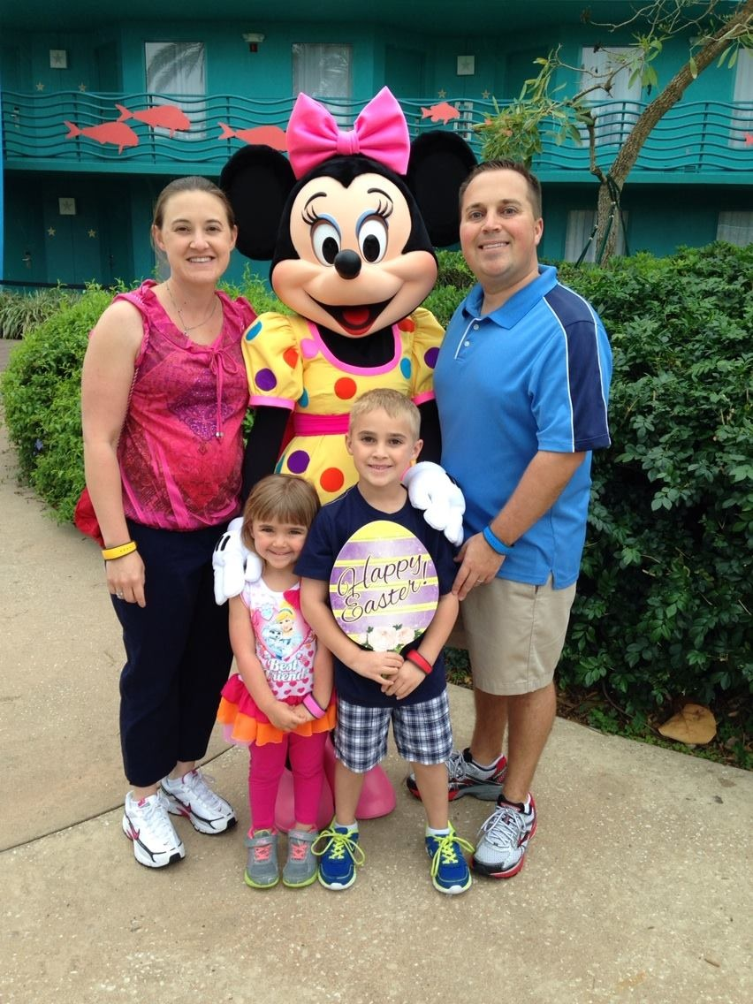
Happy Easter!
Disney bound!

Slide 4
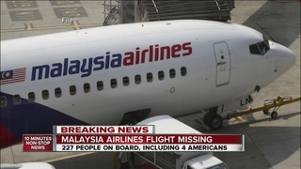
Malaysian Flight 370
Still Missing after 7 Weeks

Slide 5
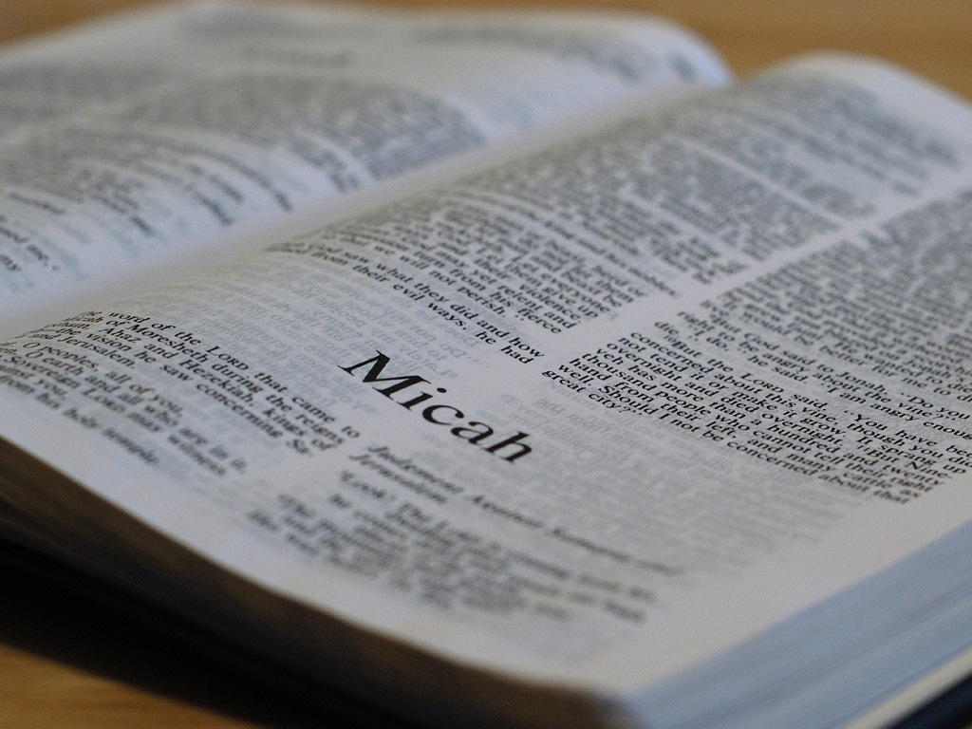

Slide 6
