Slide 1
God, Be Merciful to
Me a Sinner
Hickory Knoll Church of Christ
www.hkcofc.com

Slide 2
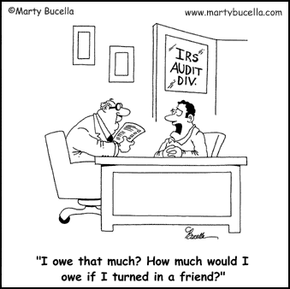

Slide 3
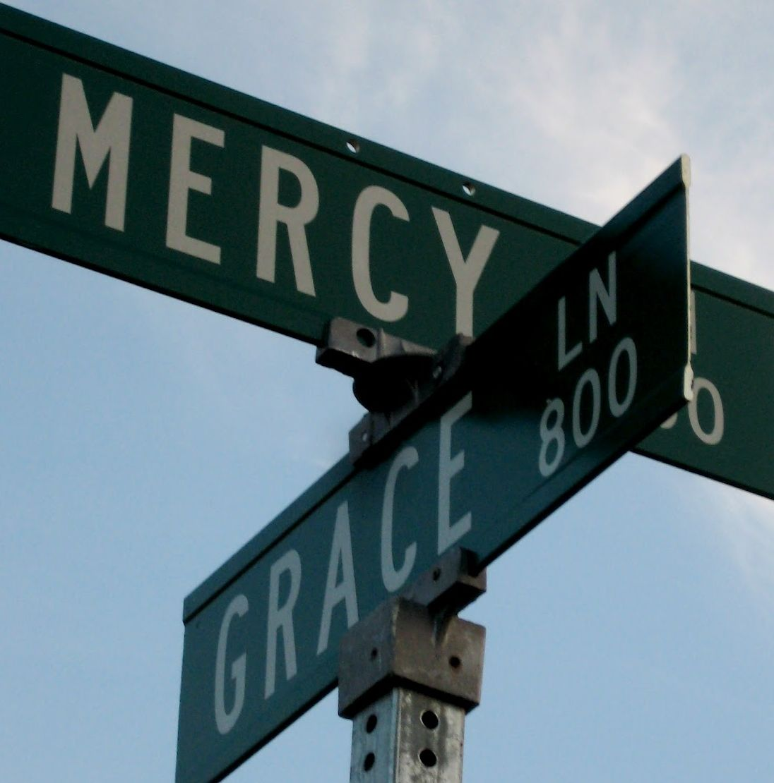
The Parable of the
Pharisee and
Tax Collector
-- Luke 18:9-14

Slide 4
Haughty Self-Righteousness
-- The Pharisee

Slide 5
Humble Self-Reflection
-- The Tax Collector

Slide 6
