Slide 1
Teacher Workshop
Hickory Knoll Church of Christ
February 26, 2012

Slide 2
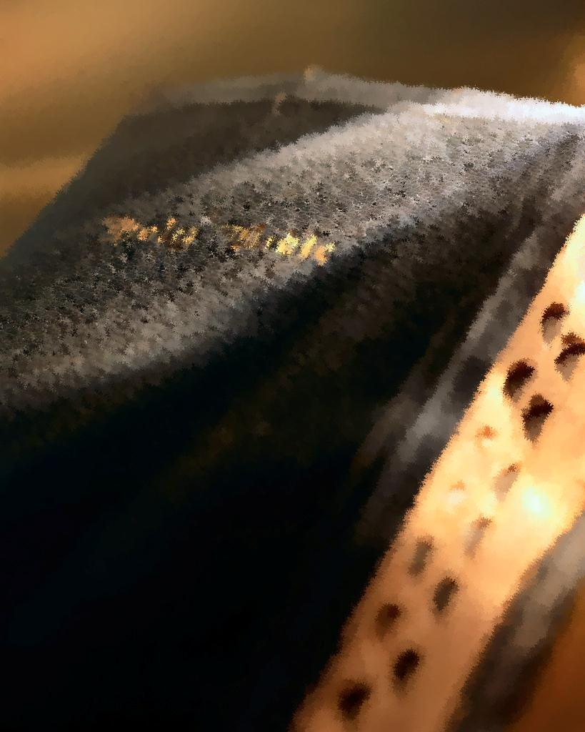
Is Bible Class Important?
Churches of Christ in U.S. have lost 102,138 members since 2003
Roughly a 6.2% loss
708 fewer congregations
http://www.christianchronicle.org/blog/2012/02/102000-fewer-people-in-the-pews-since-03-churches-of-christ-in-decline/

Slide 3
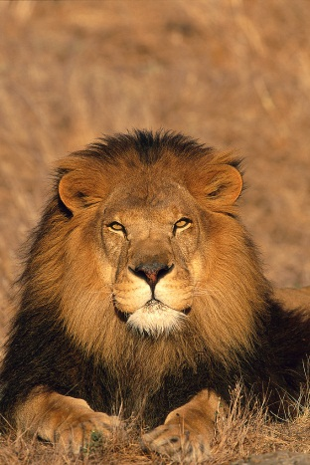
LOGb Personalities
Types
Lion
Otter
Golden Retriever
Beaver

Slide 4
Lion
Strengths
Visionary
Practical
Productive
strong-willed
Independent
Decisive
Leader
Weaknesses
Cold
Domineering
Unemotional self-sufficient
Unforgiving
Sarcastic
Cruel

Slide 5
Lion
Biblical example:
Apostle Paul
John Mark needed to leave the mission for home; Paul didn’t want him back
Sarah, Abraham’s wife
Lions need to feel respected
Dominant

Slide 6
Otter
Strengths
Outgoing
Responsive
Warm
Friendly
Talkative
Enthusiastic
Compassionate
Weaknesses
Undisciplined
Unproductive
Exaggerates
Egocentric
Unstable

Slide 7
otter
Biblical example:
Apostle Peter
Lead spokesman on day of Pentecost
Otters need to feel liked
Influencer

Slide 8
Golden retriever
Strengths
Calm
easy-going
Dependable
Quiet
Objective
Diplomatic
Humorous
Weaknesses
Selfish
Stingy
Procrastinator
Unmotivated
Indecisive
Fearful
Worrier

Slide 9
Golden retriever
Biblical example:
Abraham
Martha
Golden retrievers need to feel safe
Steady

Slide 10
beaver
Strengths
Analytical
Self-disciplined
Industrious
Organized
Aesthetic
Sacrificing
Weaknesses
Moody
Self-centered
Touchy
Negative
Unsociable
Critical
Revengeful

Slide 11
Beaver
Biblical example:
Moses
God calls and Moses has a million questions; some objections
Ruth
Beavers need to be correct
Compliant

Slide 12
Facts about personality
God made all of these different personalities
God can use all of these different personalities
Your personality will affect your teaching
Your personality will affect your learning
Your students have different personalities too

Slide 13
Learning styles
Visual
Auditory
kinesthetic

Slide 14
Learning styles
Visual
Use their eyes as primary learning source
Loves pictures, charts, and illustrations
Stare off into space when they talk or listen
“Do you see what I’m saying?”

Slide 15
Learning styles
Auditory
Listen but do not pay attention to teacher
Love the telephone and listening to music
When they read, they move their lips
“How does that sound?”

Slide 16
Learning styles
Kinesthetic / Tactile
Needs to be active
Speaks with hands and gestures
Find reasons to tinker around when bored
“How do you feel about that?”

Slide 17
God’s teaching style
1 John 1:1
What was from the beginning, what we have heard, what we have seen with our eyes, what we have looked at and touched with our hands, concerning the Word of Life— (NASB)

Slide 18
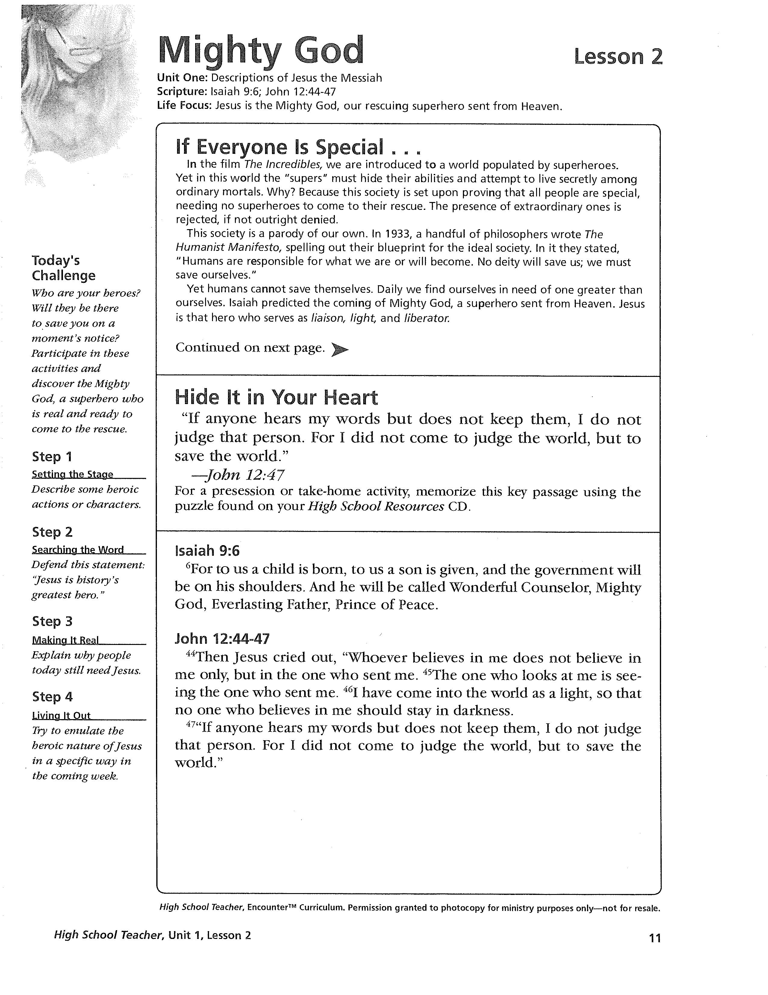
Example Lesson

Slide 19
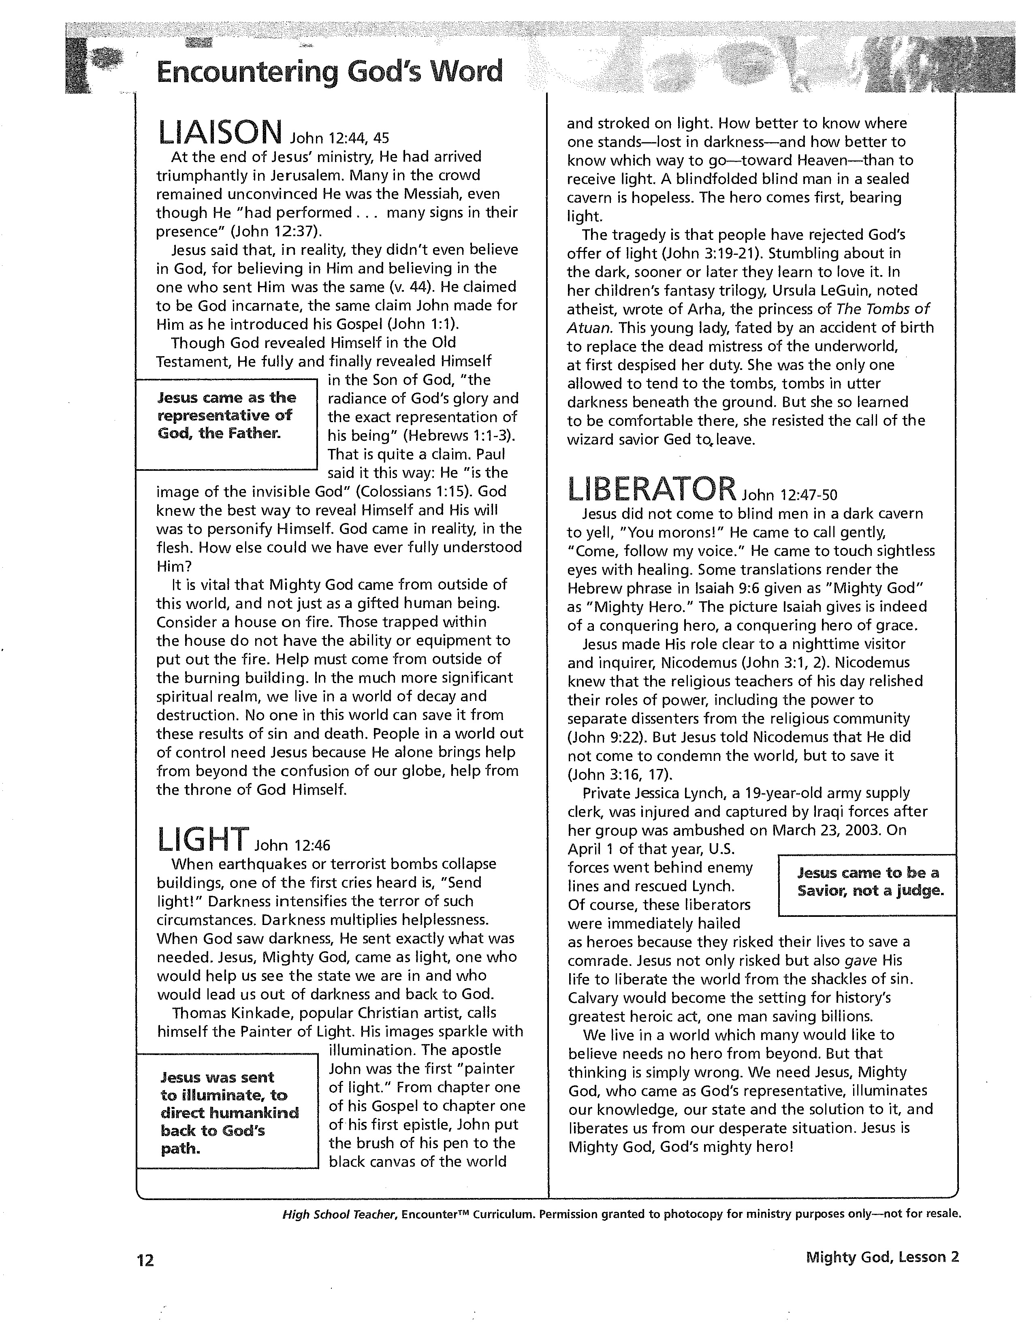

Slide 20
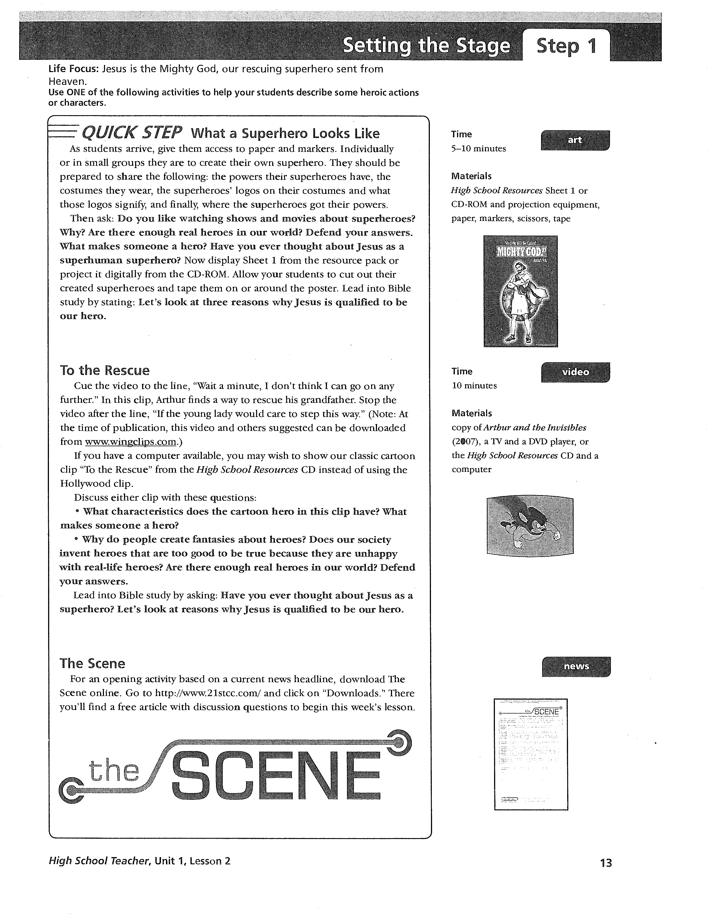

Slide 21
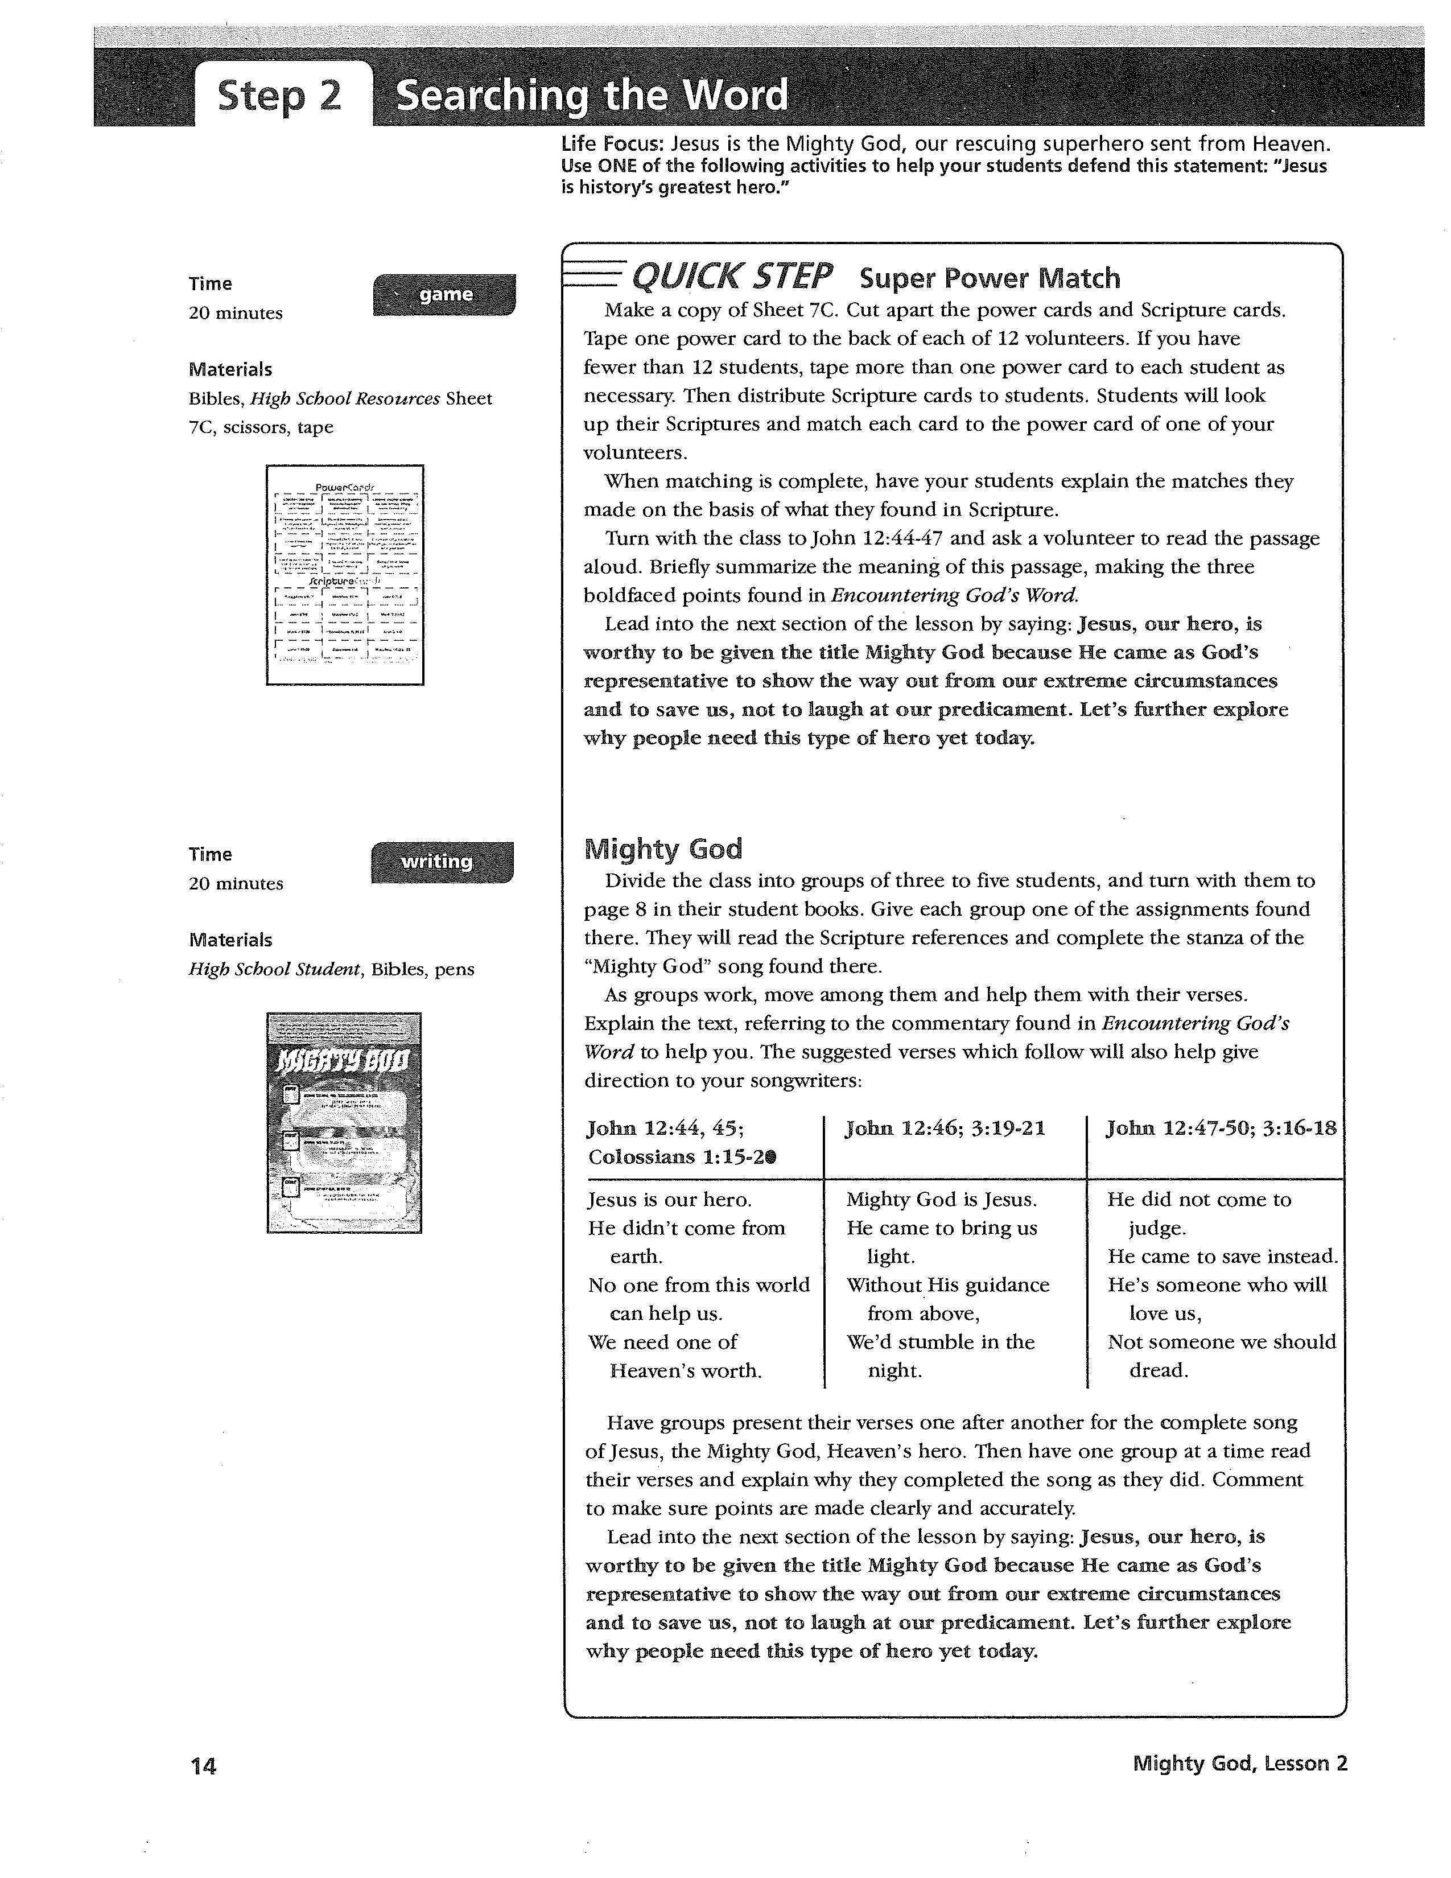

Slide 22
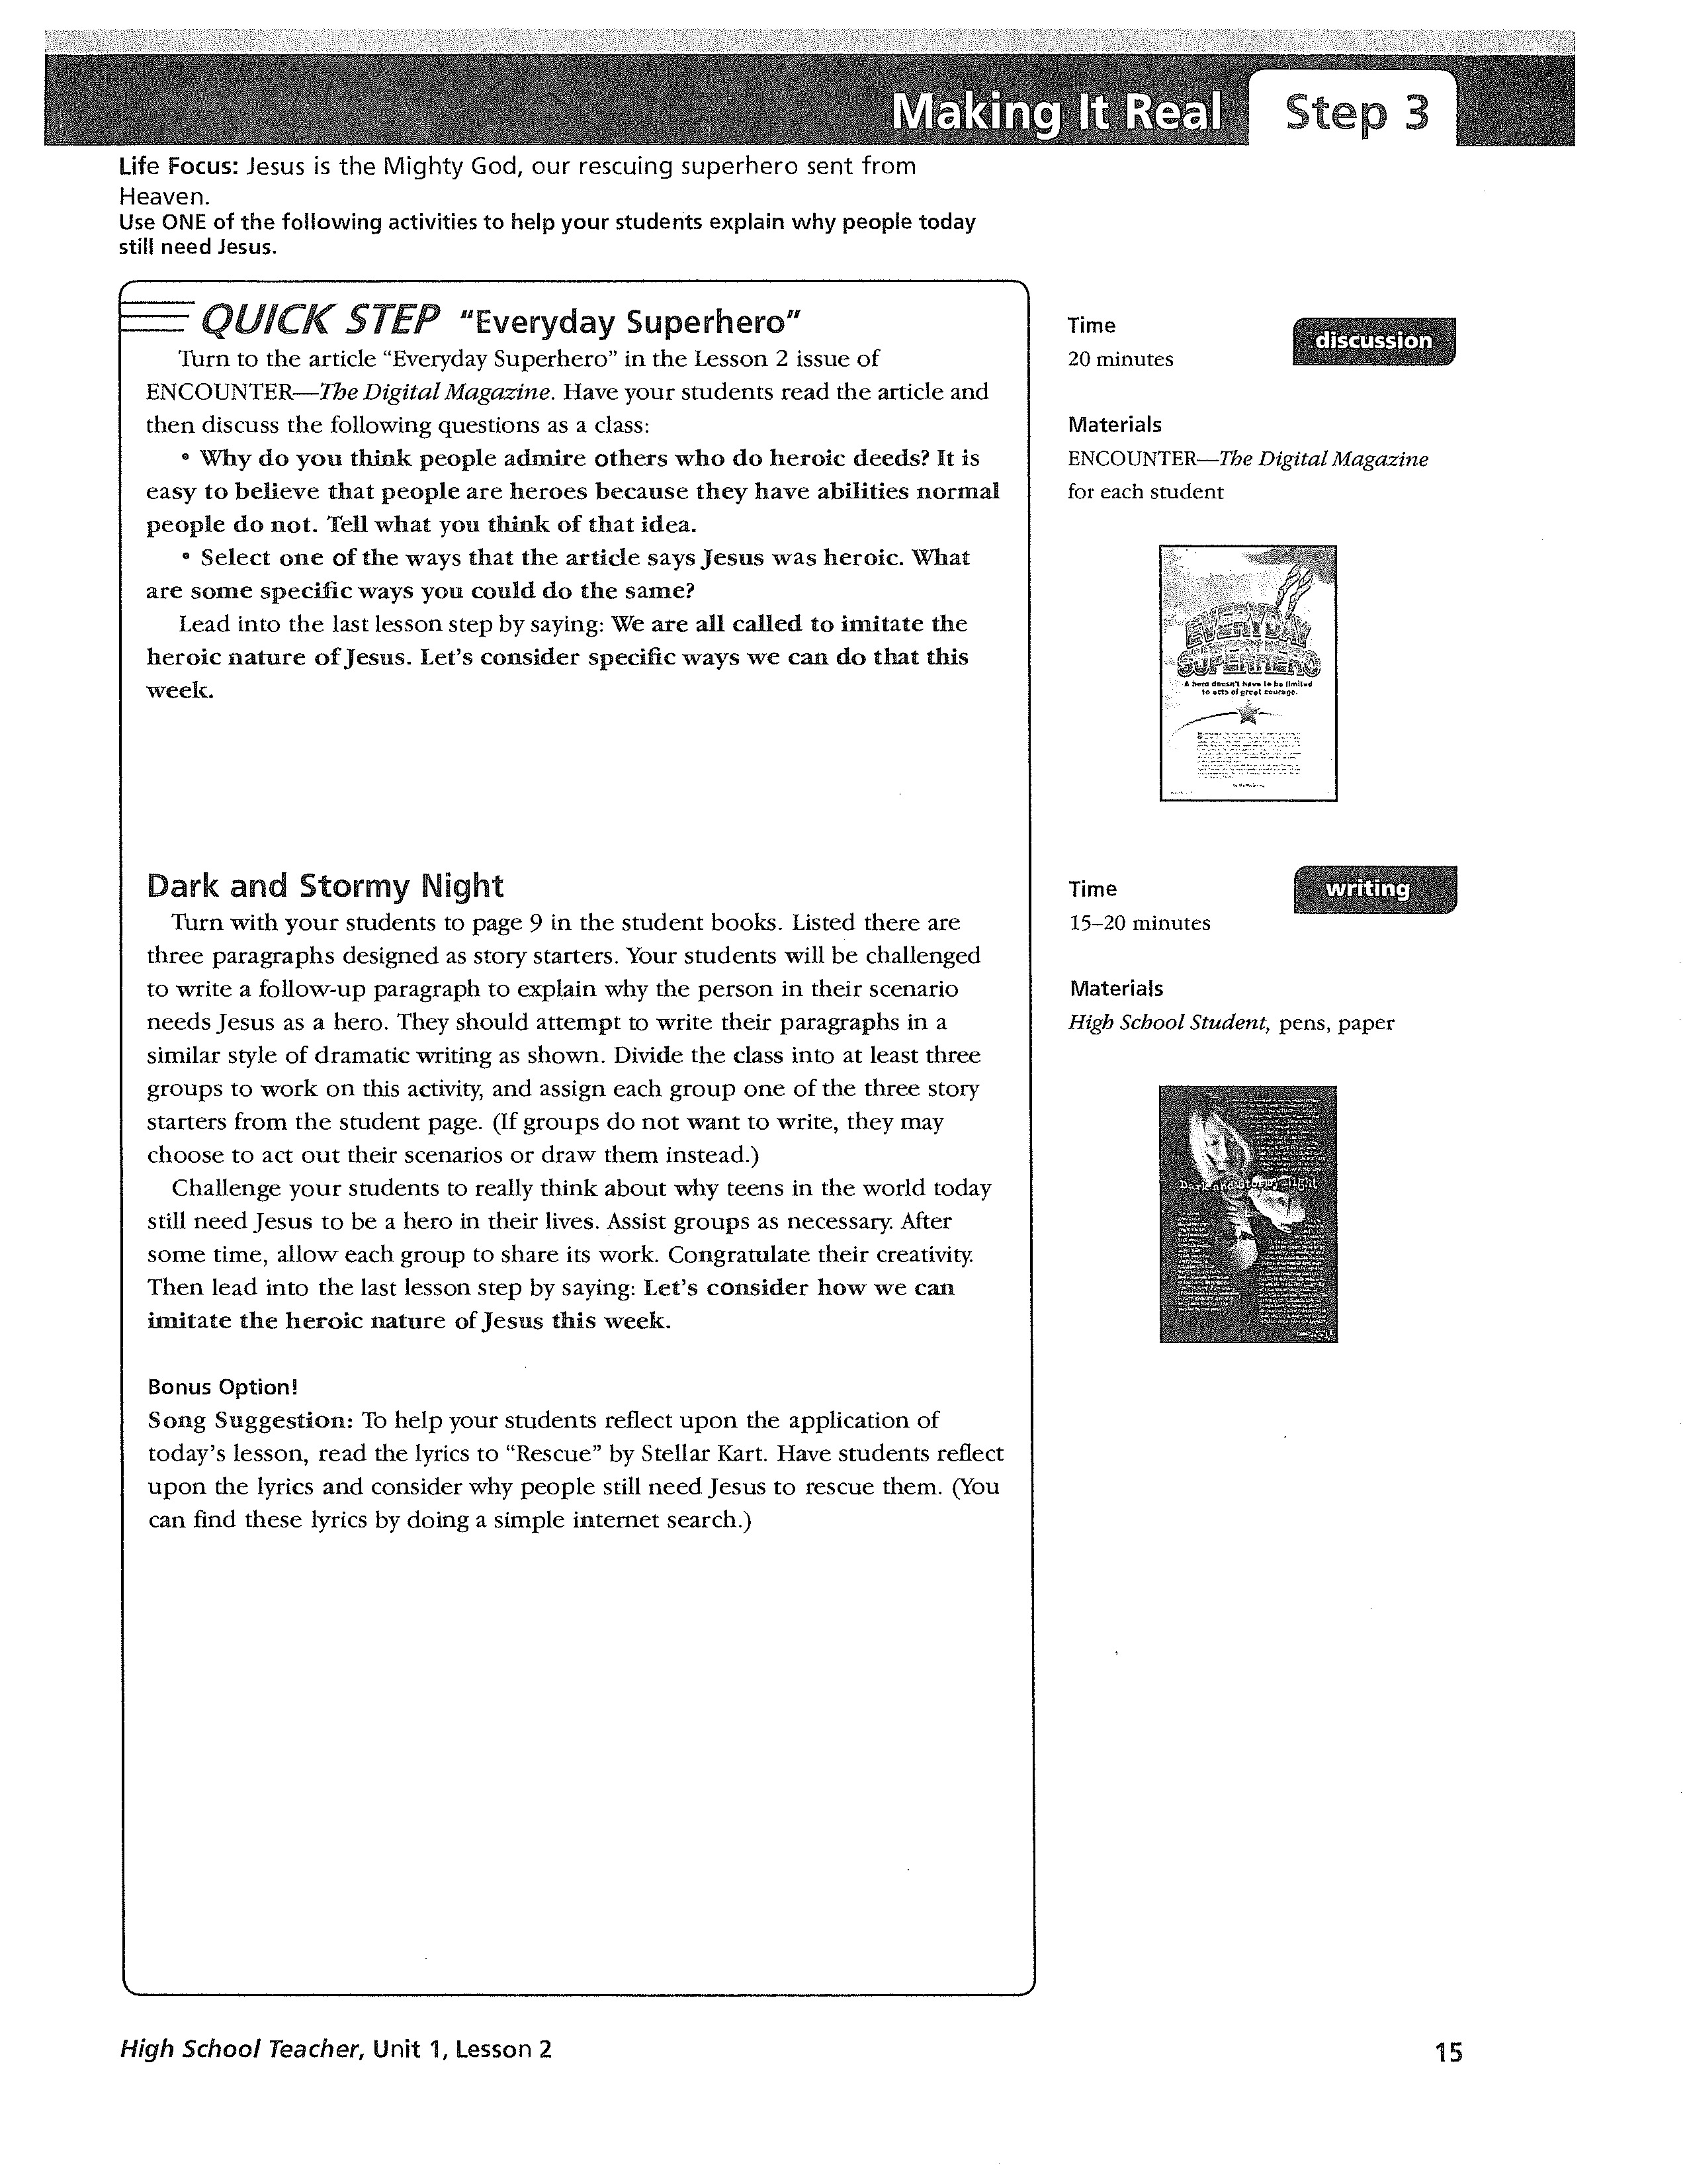

Slide 24
Who is needed?
Jonah
Isaiah
Instructed by God inform the Ninevites of their wickedness and warn of God’s wrath
Ran; eventually followed God’s instructions; unhappy to do so
Has vision of being in God’s throne room
Acknowledges his sinfulness
Purified by an angel
Volunteers to be sent!

Slide 25
Bible Class Program Needs
Teachers
Assistants
Parental involvement
Substitutes
Prize Patrol
Translators

Slide 26
Teachers
Responsibilities:
Decorate classroom
Prepare/Study for lesson
Teach lesson
Discipline

Slide 27
Assistants
Responsibilities
Maintain attendance records
Prepare memory verse material
Administer weekly/monthly memory verse quiz
Administer monthly Basic Bible Facts quiz
Collect unused lessons for mailing
Behavior modification
Issue prize tickets
Replace worn student folders

Slide 28
Substitute Teachers
Need experienced Bible Class teachers that can fill in for absent teachers
May need to teach on a last-minute basis

Slide 29
Prize Patrol
Two strong personalities that can collect tickets and distribute prizes
Keeps the Bible Coordinators informed when new prizes are needed

Slide 30
Translators
People are needed to translate announcements from/to English/Español
Need Español Basic Bible Facts
Need assistance in translating website information

Slide 31
Bible Class Program Tools
Bibles
HK Library
PCs
CD players
Projectors
Wi-Fi
Website
Facebook
Google+
Twitter

