Slide 1
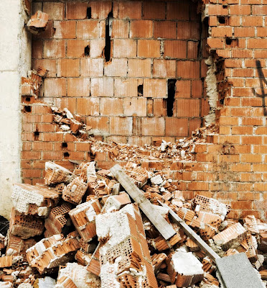
VISION

Slide 2
Purpose---------------Why? Mission----------------How? Vision---------------Where?

Slide 3
Heavenly Vision vs. Human Vision

Slide 4
Where do you think you will be? Where do you think you should be? Where do you think God wants you to be?
Picture Yourself in Five Years

Slide 5
A Vision Begins With A Concern
Nehemiah 1:1-4

Slide 6
The Next Step is Prayer
Nehemiah 1:4-11

Slide 7
But Wait!
Nehemiah 2:1
Isaiah 40:28-31

Slide 8
WHY WAIT?
A vision needs time to mature. We need time to prepare.
We can’t rush God.

Slide 9
Enlist Others In The Concern and Ask For Their Involvement
Nehemiah 2:2-8

Slide 10
GOOD IDEA or GOD’S IDEA?

Slide 11
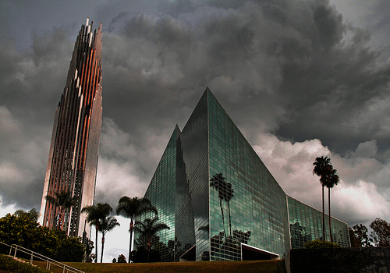
Crystal Cathedral
Anaheim, CA

Slide 12
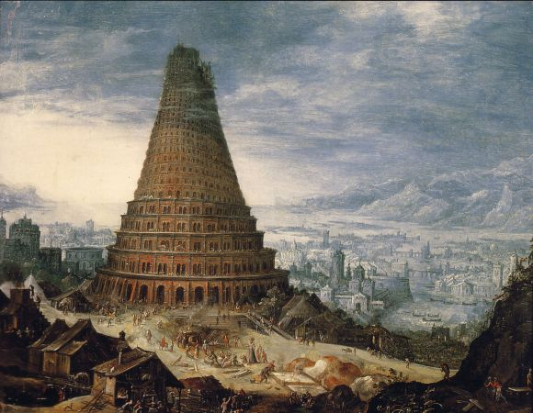
The Tower of Babel
Genesis 11

Slide 13
Is There a Moral Imperative?
Nehemiah 2:18,20

Slide 14
Is it in God’s Heart?
Acts 13:22

Slide 15
Pray- Nehemiah 1:11 Plan- Nehemiah 2:1-11 Budget- Nehemiah 2:8
Waiting Time Not Wasted Time

Slide 16
Nehemiah’s Plan
Convince the King to allow him to leave
Convince the King for financial support
Get letters from the King to the governors
Work out a deal with Asaph for lumber
Ask the King for official recognition
Organize and equip the people of Jerusalem
Begin construction

Slide 17
Walk Before You Talk
Nehemiah 2:12-16

Slide 18
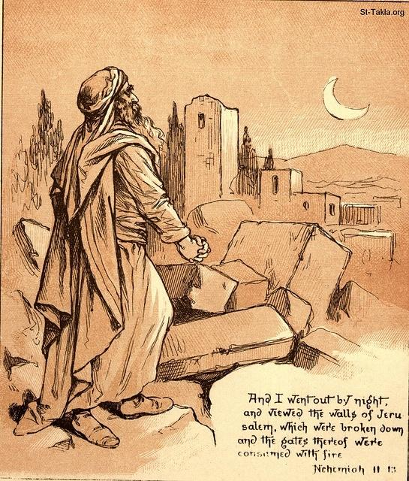
Nehemiah

Slide 19
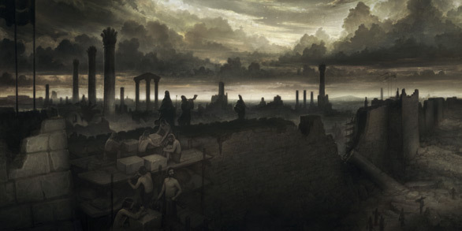
Why don’t we investigate?
Impatience--------Genesis 25:29-34
Pride---------------Proverbs 16:18
Fear-----------2 Timothy 1:7

Slide 20
What difference will it make if I…
Rebuild this wall?
Get right with God?
Save my family?
Teach my children?
Finish school?
Start a career?
Get out of debt?

Slide 21
Time to go public
The problem-------------------------------------------------------vs. 17
The Solution-------------------------------------------------------vs. 17
Why something must be done-----------------------------------vs. 17
Why we must act now---------------------------------------------vs. 18
Nehemiah 2:17-18

Slide 22
Let’s Go to Work!
Nehemiah 3
Nehemiah 4:6
Nehemiah 6:15-16

Slide 23
What about criticism?
Checks our resolve-----------------------------------------------4:1-5
Refines our vision---------------------------------4:15-17 and 6:2-3
Nehemiah

Slide 24
Don’t ignore problems
Nehemiah 5:1-13

Slide 25
Lead with integrity
Nehemiah 5:14-19

Slide 26
A vision is what could and should be. a plan is a guess as to the best way to accomplish the vision.

Slide 27
Plans change. visions are refined.
Nehemiah 5:14-19

Slide 28
Visions thrive when there is unity!
Nehemiah 4:14

Slide 29
Lead, don’t control. Resolve differences face to face. believe the best in team members.

Slide 30
Distractions to visions
Opportunities
Criticisms
fear
Nehemiah 6:1-14

Slide 31
Celebrate by giving God the glory
Nehemiah 8:1-6

